Slide 1

CAS Applied Data Science - Module 1
Data Acquisition and Management
PD Dr. Sigve Haug
Bern, 2020-08-19

Slide 2
Presentation Round
Everyone introduces herself and himself
Name tags for tables not needed as we use Zoom
Security measure concept
Check Zoom features
Tell your name, education, work/hobby, possible dataset (take note of the people you find interesting), 15 sec each

Slide 3
Learning platform
University of Bern uses Ilias
Several entry paths:
http://cas-applied-datascience.unibe.ch
www.scits.unibe.ch -> Training
You need to login with your UNIBE campus/Ilias account
Get the slides there now ...

Slide 4
Sign up for electives
Published here:
http://www.scits.unibe.ch/training/training_and_workshops/
Have you booked your room in Muerren?
https://ilias.unibe.ch/goto_ilias3_unibe_crs_1801120.html
If you cannot attend that week in Muerren, the same school happens the week after (more students):
https://ilias.unibe.ch/goto_ilias3_unibe_crs_1801289.html
Notes:
DSF 4 – statistic, not needed in M2
DSF5 good to take
GPU programming CUDA, for advanced programer

Slide 5
CAS Forum / Chat ?
Chats are important when working together
Organise yourself on Slack, Skype, WhatsApp, Signal … whatever you use
On Ilias I have configured a Forum

Slide 6
Module 1
Purpose and Format
Purpose
Think about data
Get used to the tools for working with data
Establish the tacit skills needed for the other modules
Not very theoretical (if you already know a lot, may work with the notebook on your dataset)
Format
Presentations intersected with discussions and hands on work
Not inverted class room (as module 2)

Slide 7
Module 1
Overview
First day
Setup
About data and working with data
Data infrastructures
Second day
Visualisation of data
Databases
Third day
Data management and planning
Retrieving data from www
Project clarifications
Project
Written report with deadline 2020-10-XX to be defined

Slide 8
First half day
09:00 Introduction
Getting known and onto Ilias and slack (30m)
Data and Big Data (09:30)
Environment installation (10:00)
Your datasets
10:30 Break
11:00 Working with data
Getting used to Jupyter and DataFrames with our first notebook
12:30 Lunch

Slide 9
Data (latin datum in singular = thing given)
Data
Term first used in relation with computers in the 40-50ies
Plural but often used in singular
Means any sequence of symbols
Needs processing and interpretation to become information
A lot of information and experience become knowledge
Digital (represented by 0 and 1) or analog
Moves serial or parallel
Stored on magnetic (tapes, hard disks), optical (CD, DVD) or mechanical devices
Most computers work on digital data and with the binary numeral system (“alphabet”)
Notes:
Knowledge: True believe?

Slide 10
Data
Data example
Radius of the earth
46 100 km
In this case value with unit
Normally only the value is stored
Metadata (data about data) example
Unit: km
Author: Eratosthenes of Cyrene
Date: 240 BC
Location: Egypt
Method: Well, stick, shadow
Notes:
Metadata: what it means

Slide 11
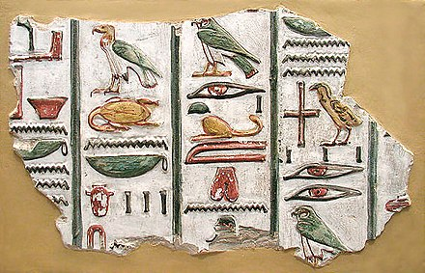
Data
01001000 01100101 01101100 01101100 01101111 00100001
“Hello!”
?
Data -> Information -> Knowledge -> Decision

Slide 12
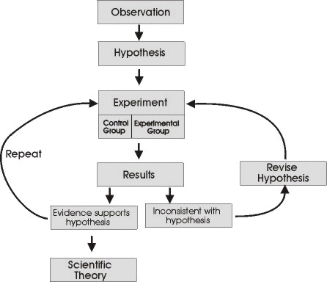
Data and Science
Science
The enterprise of building and organising knowledge
Ideally based on reproducible experiments (since Galileo’s time)
Should produce falsifiable predictions (normative definition - Popper)

Slide 13
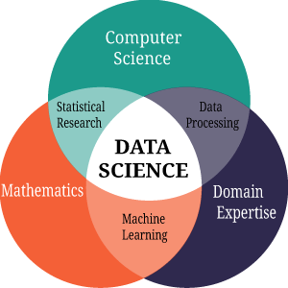
Data
Data Science
Uses
Mathematics and Statistics
Computer Science
Domain expertise
on data to build information and extract knowledge (for decisions and actions)
Very general skills increasingly needed in all empirical research and business
Notes:
Need to have all those skills within the team!
Need to know your data!

Slide 14
Data Representations
Numeral Systems
Data is mostly represented by numeral systems
Writing systems for expressing numbers using e.g. digits
Modern systems are mostly positional systems
304 = 3×10² + 0×10¹ + 4×10⁰
Examples Numeral Systems
Unary (2 = //) - base 1
Good for kids
Binary (2=10) - base 2
Good for computers
Decimal (2=2) - base 10
Good for grown ups
Sexagecimal - base 60
(remnants in hour, minutes etc )
Notes:
Sexagecimal: easy to divide it by 2, 3, 4, 5, ….

Slide 15
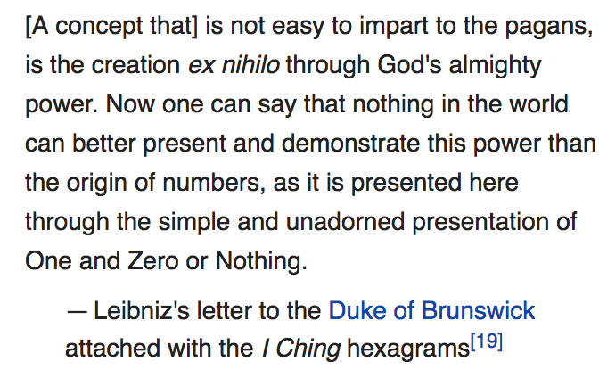
Most Computers understand only 0/1

Slide 16
Data
Binary numbers
Base 2, e.g. 0 and 1
Computers work with electrical currents, either there is a current (1) or there is no current (0)
Other numbers and characters can be represented with binary numbers
One can do mathematics with 0 and 1
So in the end data is mostly stored as bits and processed as bits
From 0 to 3
0000 0000 (8 bits = 1 byte)
0000 0001
0000 0010
0000 0011
….
1111 1111 (2^8 = 256)

Slide 17
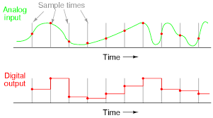
Analog to Digital Data (Digitisation) - ADC
Digitisation
Sensors often produce analog data - often perceived as some continues wave
Is then often converted to digital data for computation and storage as bits
Lately an inflationary usage occured - digitisation is now also a social process and every institution needs a digital strategy
...
...
Discretisation
Quantisation

Slide 18
Data types and structures
Explicit and implicit declaration
In programming languages data is loaded into variables of certain types
In Python and R types normally don’t have to be specified.
counter = 2
In C/C++, Fortran … data types must be specified
Int counter
Float strength
Common types
Integer (e.g. 32-bit int)
Floating point (for real numbers), 32 or 64-bit (double) float
Boolean (True or False)
Character (a,b,c ...)
String (“list of characters”)
List or Array ([1,2,r,t,5])

Slide 19
Data types and structures
Composite data types
Arrays, matrices, dataframes
In C/C++: Structures
Person (name,age,gender)
A structure with method (s) or functions are called classes
An instance of a class is often called an object
Trees
Graphs
...
In R and in the Python pandas module, dataframe is the essential data (composite) type

Slide 20
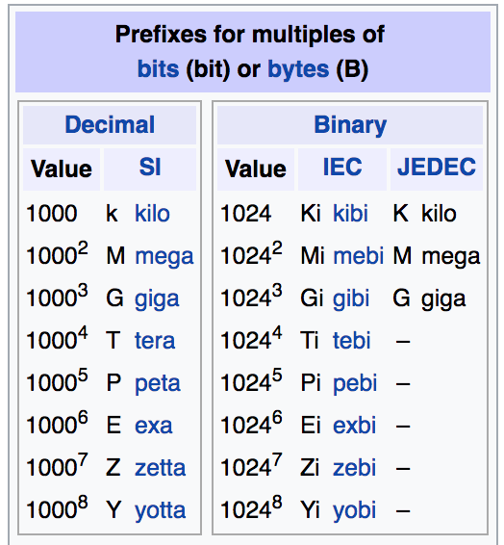
Data and some vocabulary
Unit prefixes

Slide 21
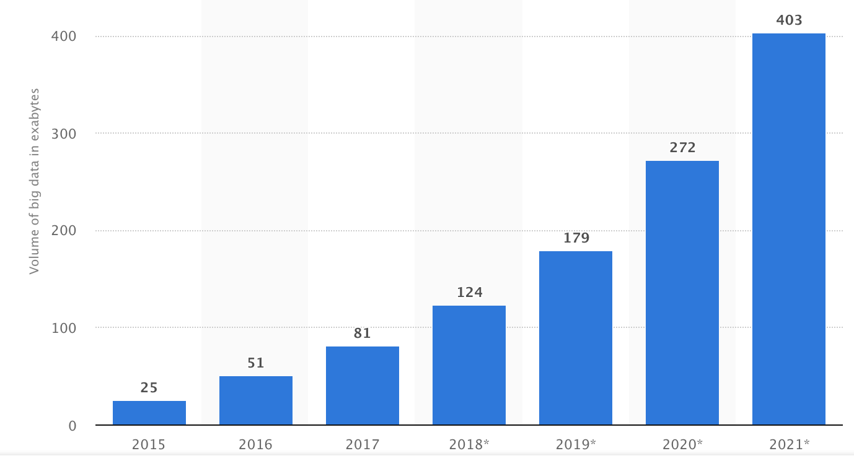
Data volumes
Sizes
An integer number is often 4 bytes
A character is often 1 byte
My 2017 laptop has 8GB RAM
In 2007 all digital data was 281 EB
In 10 years one expects 40 EB of new genetics and genomics data
(Microscope image) - 3 numbers per pixel
Statista.com : big data in data centers

Slide 22
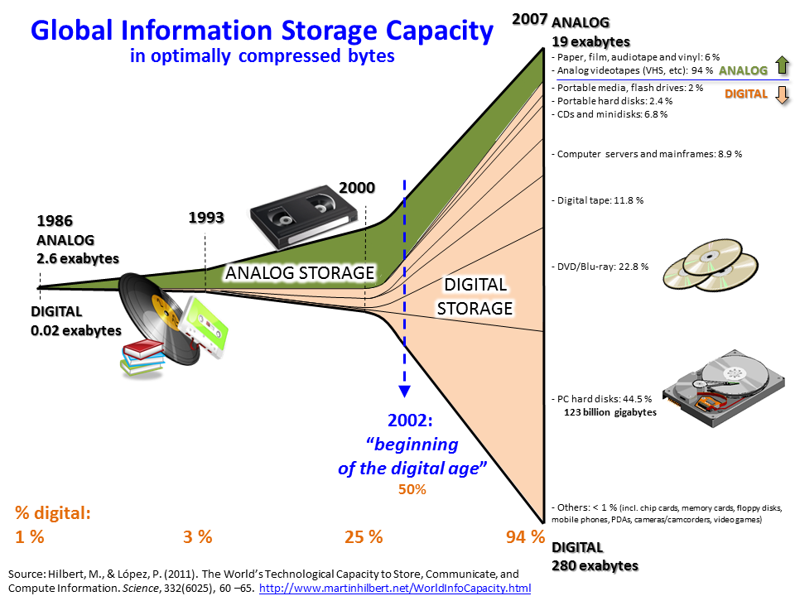

Slide 23
What is big data ?
Relative
Too big for your “traditional” tools
Paper is not good for tens of rows
Spreadsheets are not good for more than million rows
Database management system may not be good for data more than the computer memory
Advanced processing
Parallel processing over distributed systems
Systems are orchestrated with HPC/SLURM, Hadoop, Spark … or grid technologies
The processing is done with C++, Python, R or other programming languages with parallelism capabilities

Slide 24
Data Quality
Definitions
Condition of the values of the variables
ISO900:2015 Data quality can be defined as the degree to which a set of characteristics of data fulfills requirements.
Characteristics
Accuracy
Validity
Completeness
Availability
...
The best analysis, ML and inference will not help you if the data quality is poor

Slide 25
Data Quality
Assurance
Profile (descriptive statistics) and cleanse data
Control
Before and after the Assurance
Restrict the inputs
Check the quality according to definition
Data cleansing
May need to cleanse data with respect to
Consistency
Format
NA/NAN
Outliers
...
Before processing/analysing it

Slide 26
Data is stored in files
Files
Files have different format (standards) for different purposes
Modern file systems on computers support sizes up to some TB
Many small files are hard to organise
Big files are hard to move
File formats
Binary file (not human readable)
Text
Comma separated values (csv)
gif, pdf, tiff … (graphics)
mp3, mp4 (sound)
And so on

Slide 27
Summary and Readings
Test yourself
What is data, science and data science?
List common data types and structures
What are binary numbers and why are they important?
What is big data?
What is data quality?
Literature
Wikipedia on all topics
Zacharias Voulgaris, Data Science: Mindset, Methodologies, and Misconceptions, 2017
D. E. Holmes, Big Data - a very short introduction, 2017
D. Faser, A. Meier, Big Data (german/swiss), 2016

Slide 28
Time to get started with our data science platform and Jupyter
...
...

Slide 29
Data science platform
Anaconda
Free open source
6M users in 2018
Comes with GUI, Python, R RStudio, Jupyter …
Linux, MacOS, Windows
...
https://en.wikipedia.org/wiki/Anaconda_(Python_distribution)

Slide 30
Install Anaconda, launch Jupyter
Steps
Go to Download on the Anaconda webpage
Download and install Anaconda with Python 3 for your OS
Install R from the command line: conda install -c r r-irkernel
...
Install more packages ...
Start the Graphical User Interface (GUI) : anaconda-navigator
Launch Jupyter Lab and open the first notebook on Ilias

Slide 31
Create your GitHub CAS repo
If you don’t have one, create your GitHub account
If you don’t have one, create your GitHub account
Create a CAS repository
Upload your CAS material there
You will learn more about GitHub and git in Module 4

Slide 32
Datasets to work with
Choose your own or take
Bring your own from work or research (on laptop)
Search internet
If your set is too big … tell me
a public dataset
https://archive.ics.uci.edu/ml/datasets.html
https://www.kaggle.com/datasets
You may (ideally) work with one dataset through the whole CAS or use severals according to what is to be done.

Slide 33
Second half day
13:30 Infrastructures for data
With visit to a data center (cancelled)
14:00 Work on Notebook
14:30 Data sources and modelling
Data flow
Data modelling
15:00 Break
15:30 Team Work
16:00 Team work presentations
16:45 Summary
17:00 End

Slide 34
Infrastructures for data
From small to big - scaling
R&D is normally done on small datasets, i.e. laptop size infrastructure
Production may start small but can scale quickly, larger infrastructures are needed
You may start with 10 users/customers/MB per day. One server is enough. May need to serve million times as much in some years
...
Such scaling is not possible/feasible on premise infrastructures (buildings, electricity, procurement, expertise ..)
Move application to cloud providers or other providers of larger infrastructures
Scaling beyond the limits of one data center is traditionally called grid computing (we don’t talk much about that)

Slide 35
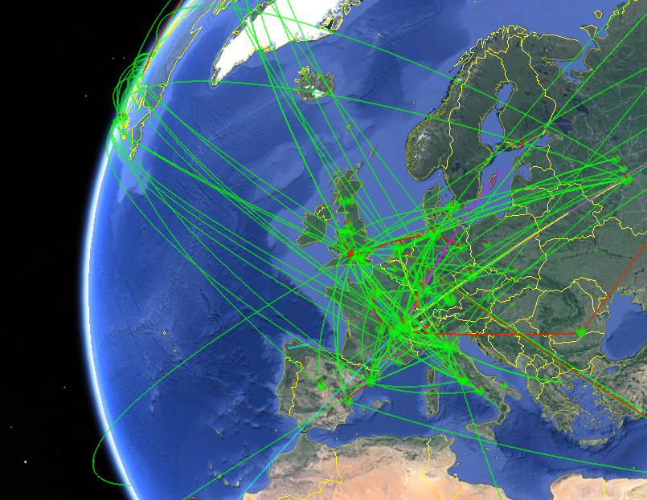
Infrastructures for data
Parts (of a global system)
Sensors
Storage
Compute
Network
Interfaces for humans
The essential part is the computer
Snapshot of data movements in the WLCG data infrastructure

Slide 36
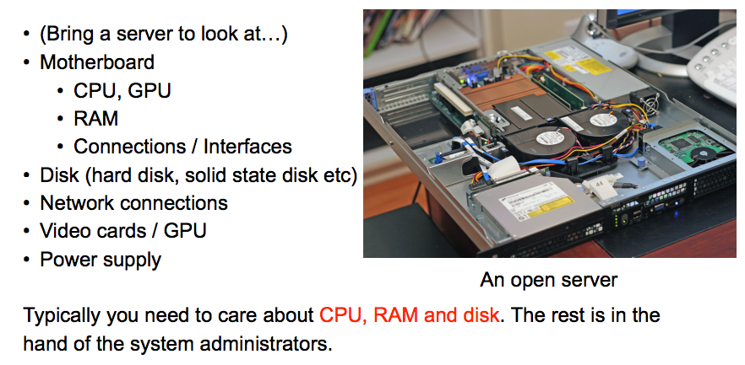
What is a computer ?

Slide 37
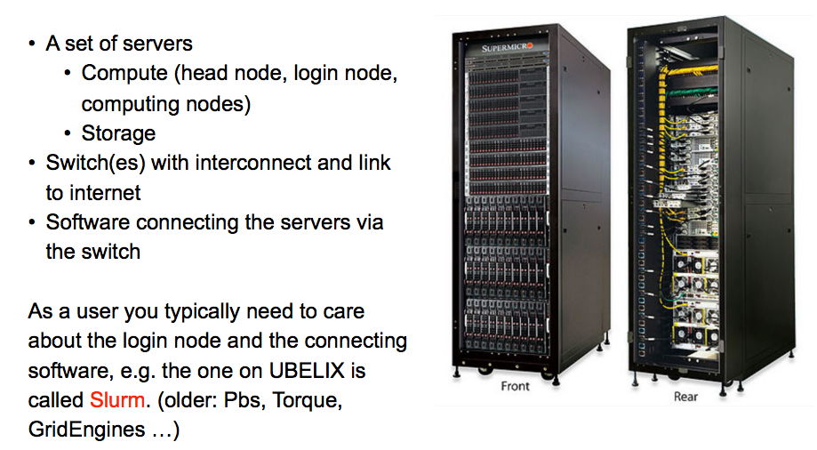
What is a cluster / data center ?

Slide 38
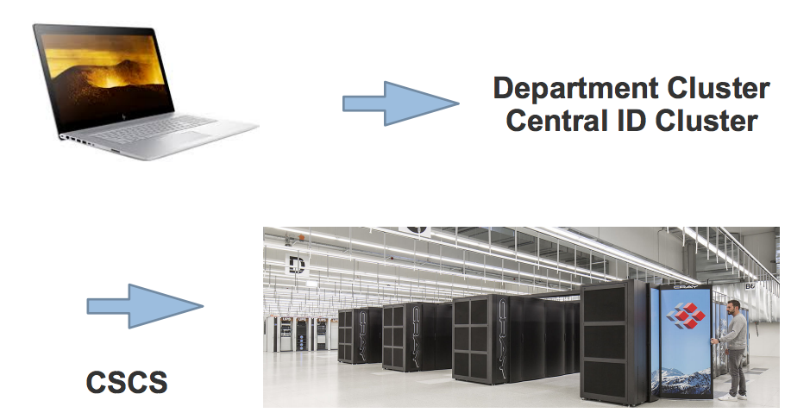
From laptops to supercomputers (academic)

Slide 39
The pyramid of computing infrastructures
Storage/PB
10³
10²
10¹
10⁻⁴
Cores
10⁵
10⁴
10³
10¹
Typical 2019 sizes you can get
Supercomputers
Private and public clouds
On premise data center
Laptops/desktops/workstations

Slide 40
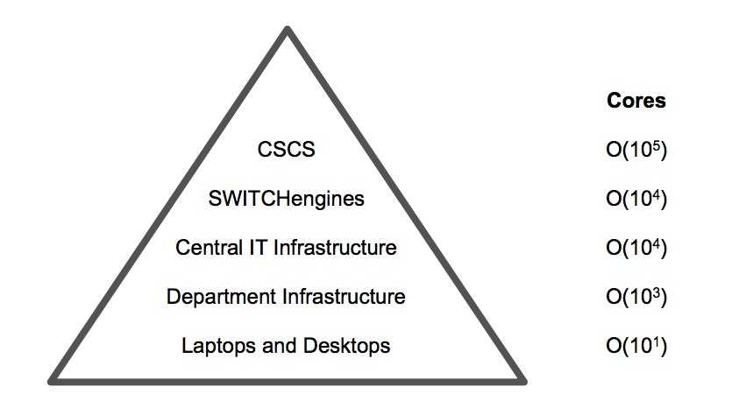
The CH pyramid of academic computing infrastructures
Storage/PB
10³
10¹
10¹
10¹
10⁻⁴
Cores
10⁵
10⁴
10⁴
10³
10¹

Slide 41
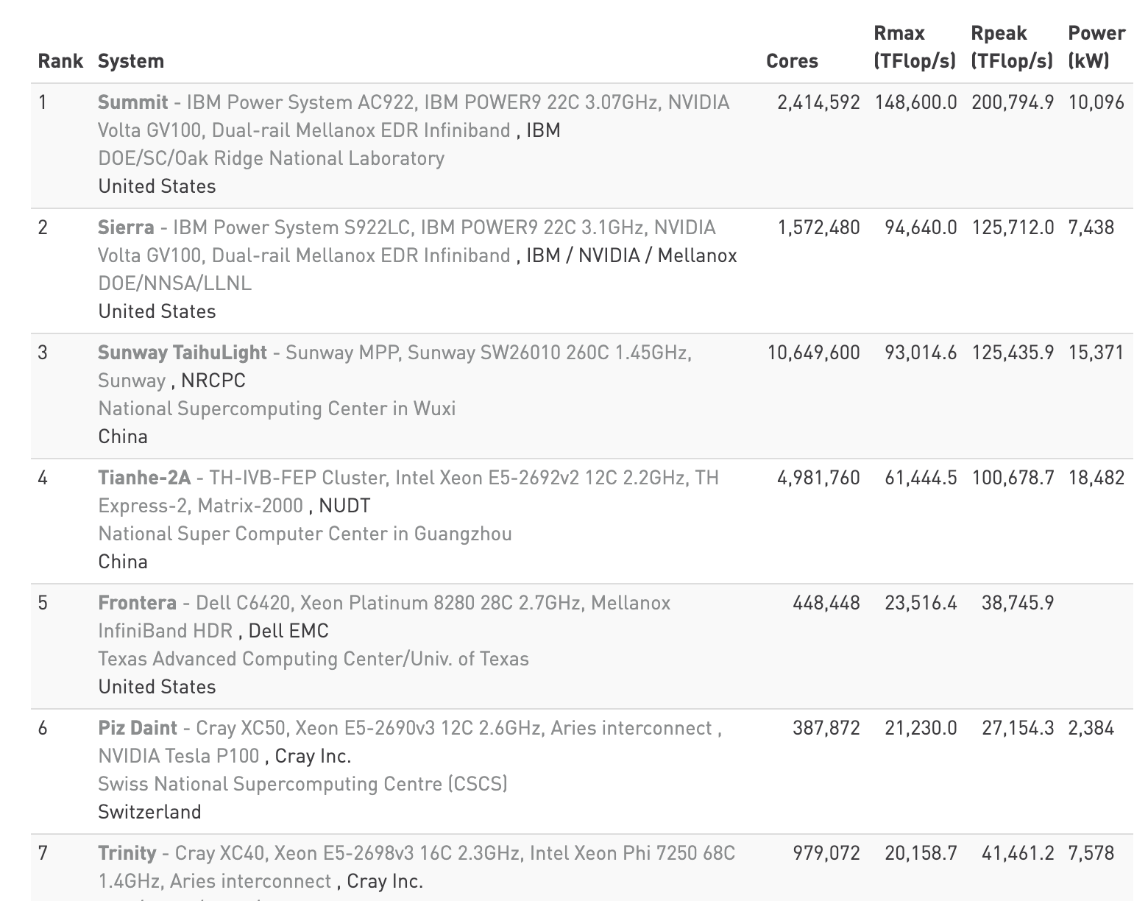
www.top500.org
Amazon/google/etc data centers are an order of magnitude larger than CSCS

Slide 42
How to use HPC/Supercomputers
UBELIX HPC Cluster at UNIBE
Short demonstration
Notes:
Look at the webpage, Login and run an example job
Sinfo
Squeue
Sbatch test.sh

Slide 43
Infrastructures for data
Vertical systems
Laptops/workstations/confined clusters scale vertically
You can add more RAM and more storage to a certain limit
Cons: Expensive as non-mass produced components needed, limited to the sortiment of the provider
Horizontal systems
Just add more commodity hardware (stays cheap)
Do it in a “cloud” or another data center provider (no hardware procurement or maintenance)
Cons: More knowledge, expertise and software technology needed

Slide 44
Infrastructures for data
Vertical systems
Optimal performance / alignment between storage, CPU and network (limited scaling)
Often a turn-key ready solution designed and tested for a certain scale
Horizontal systems
Shared parallel file system (spfs) or Hadoop like solutions
Spfs may require high bandwidth network (typically on HPC/supercomputers, not in the cloud)
Spfs is data to compute
“Hadoop” is compute to data

Slide 45
Infrastructures for data
Cloud
Pay as you go with credit card
Little support for small users and special needs
Economy of scale
Scales well
On premise/HPC/supercomp
Up front investment
Limited amount of use cases -> better support
Scaling beyond planning is difficult

Slide 46
Infrastructures for data - price considerations
Cloud
Monthly billing on your credit card
Prices are public (but not always very transparent)
If the usage of a machine/system is below 50%, for sure something to consider, only pay for usage
Infrastructure within minutes, minimal bureaucracy (only money)
On premise
Mostly upfront investment
Infrastructure used at 80-90% may be cheaper, but doesn’t scale
If you don’t see electricity, sys admin costs, etc (subsidized by company/organisation) something to consider if usage is around 30%
30-50% of a datacenter cost is electricity for the computers and cooling

Slide 47
Infrastructures for data
Lifetime considerations
Typical replacement of equipment every four years
Runs longer but failure risk increases
Out of warranty
Electricity consumption per calculation and storage goes down with new equipment
...
Procurement, installation and commissioning is expensive and time consuming
Cloud solutions hide all this

Slide 48
Infrastructures for data - main providers
Public cloud
Amazon AWS
Microsoft Azure
IBM
Google
Oracle
Alibaba
...
CH academic sector
Your department infrastructure
Central IT infrastructure (often for free)
SWITCHengines (cloud provider)
Swiss Super Computing Center (CSCS) in Lugano

Slide 49
Infrastructures for data - price considerations
Examples
Amazon, google, Azure
SWITCHengines (Swiss academic)
Buy your own computer (center)

Slide 50
How to use commercial clouds
Amazon AWS
Demonstration if time
Notes:
Look at the webpage
Login and start a machine

Slide 51
How to use an open stack cloud
SWITCHengines
Demonstration if time
Notes:
Login and start a machine via web interface

Slide 52
15: 30 Break
A nice data science page
www.kaggle.com

Slide 53
Data acquisition (from primary data sources)
The physics
There are 4 fundamental interactions in nature
Gravitation
Electromagnetic
Weak nuclear force
Strong nuclear force
Examples
Keyboard (macroscopic pressure)
Microphone (sound)
Camera (light, em wave)
Temperature ()
Eye, ear, skin
All about releasing electrical charges

Slide 54
Data acquisition (from primary data sources)
Process
Physical signal is detected by sensors converted into electrical signal
Electrical signal can be conditioned
Electrical signal is digitised
Maybe amplified, transported
Stored to a physical device
Data acquisition (DAQ) system
Example Mobile Device
Bike with GPS and internet
Time and position
Camera and sound
Temperature, vibrations …
…
Pushes data to an internet server

Slide 55
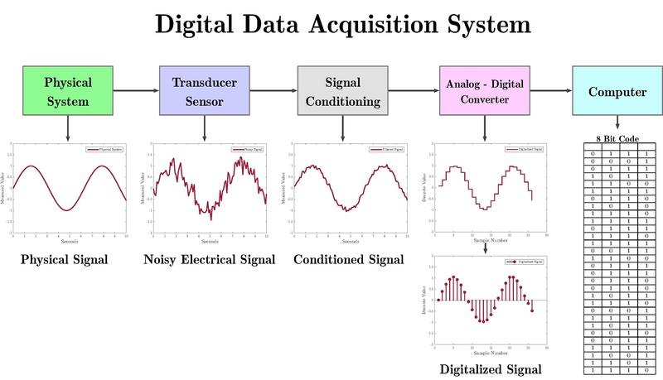
Data acquisition

Slide 56
Data acquisition (from secondary data sources)
Secondary data sources
Data storage (wood, stone, paper, tapes, hard disks, solid state disks, human memory, computer memory)
Online data storage (accessible with wired or wireless internet)
www increases the access to secondary (and primary) data sources dramatically. We will look at data collection from www on day 3
IoT
Internet of Things
Increases the access to primary data
Devices have sensors connected to internet
Cars, houses, drones, fridges, animals, humans ...)

Slide 57
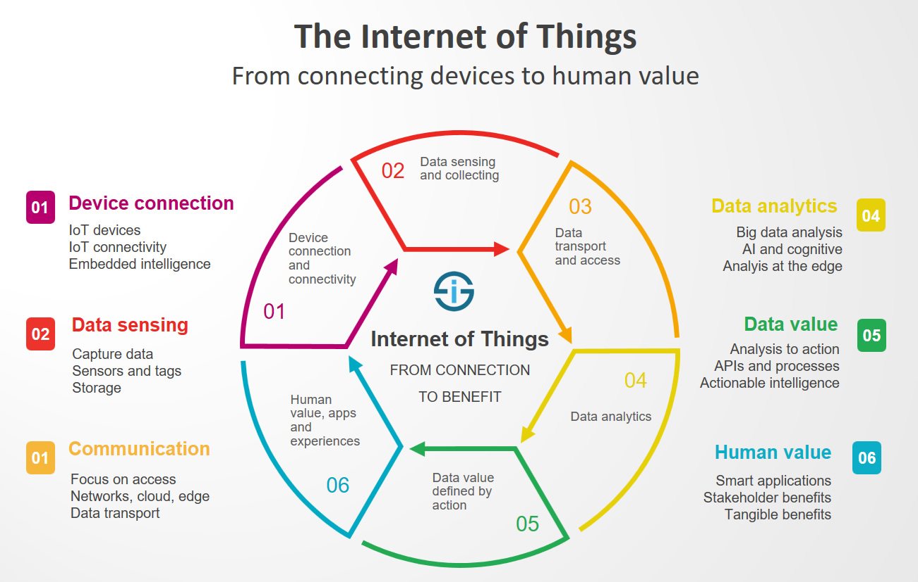

Slide 58
Much competitive business and research must leverage the new situation - www, IoT, big data, ML, AI, computing power
New skills are required from the data scientists

Slide 59
Data Flow Analysis
Data Modelling
(Brief)

Slide 60
Analyse the dataflow
Why
Know your data, needed for good inference / data science
Data flow may have impact on the data quality
Identify risks and incompatibilities in the DAQ and computing system
Make appropriate data model and structure
Data flow
From input source via
Network
Storage
Preprocessing
Analysis
Output storage
Presentation (publication, talk)
Lobbying / Convincing
Decision

Slide 61
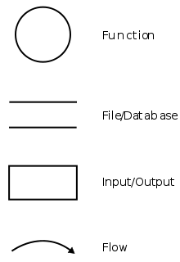
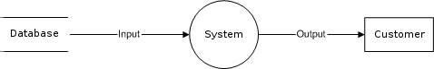
Data flow diagrams
How
Some diagram standardisation suggestions exist
However, important is that the diagram is serving its purpose
Symbol suggestions

Slide 62
Data flow diagrams
Our Iris data set case
archive.ics.uci.edu/ml/datasets/iris
Laptop file
Python dataframe
Analysis
Plots
Tables
Output files

Slide 63
Analyse the data flow - physical data model
Concerns
Data set size at each step
Storage types, backup
Velocity (time between steps)
Memory considerations
Lifetime
Formats
Analysis tools
...
Analysis time
CPU capacity
Bandwidth capacity
...
All gives requirements to your data infrastructure

Slide 64
Analyse the data flow - logical data model
Concerns
Data set organisations (multiple files)
Metadata organisation
File organisation
Data organisation within files
Data organisation within databases (tables, columns ...) see day 3
...
Data structures in analysis tool
Pandas dataframes
R dataframes
Some classes
etc

Slide 65
Analyse the data flow - conceptual data model
High level
Terms/entities and relationships between them
Not the actual data model design (logical)
Not the physical data model
Order
Normally
Conceptual
Logical
Physical
However, all levels may restrict each other

Slide 66
Team work - 7 Teams (30 Minutes)
You can do this in a notebook, on paper in the room or on some slides
Formulate a data science challenge or take this one:
Mapping Bern road surface conditions with Publibikes
Sketch the data flow diagram
Sketch/tabulate the conceptual data model
Sketch/tabulate the logical data model
Sketch/tabulate the physical data model
Presentations at 16:00

Slide 67
Summary (16:45 - 17:00)
...
....
Fill this survey (mandatory) before leaving, also linked on Ilias:

Slide 68
CAS Applied Data Science - Module 1
Data Acquisition and Management
End of day 1 - tomorrow data visualisation and databases
Bern, 2020-08-19

